Slide 1


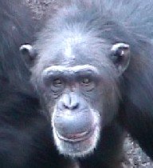
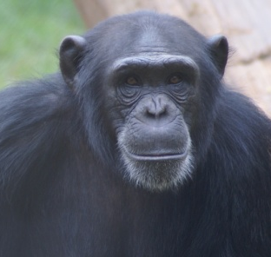
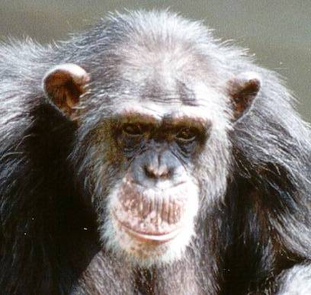
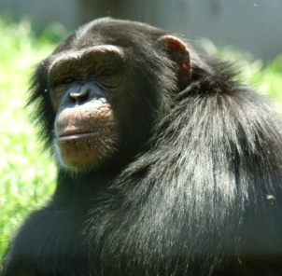
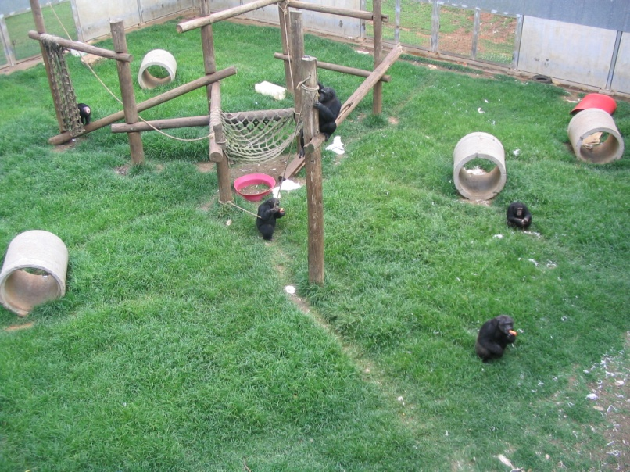
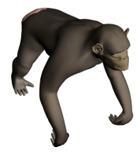
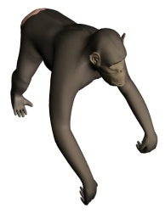

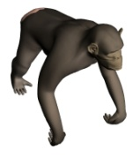
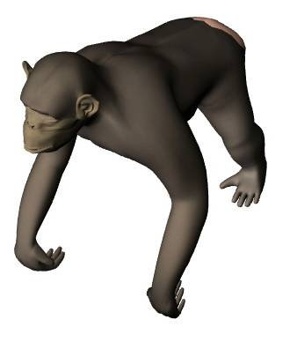






The role of physical proximity in a social-learning model choice task
Darby Proctor^{1,2}, Victoria Horner¹, Frans de Waal¹
¹Living Links Center, Emory University; ² Language Research Center, Georgia State University
Introduction
Results
Conclusions
Chimpanzee traditions are well documented in the wild¹. Of recent interest is how chimpanzees pass on these traditions to multiple generations^{2, 3}. This study explored the possibility that, like humans, chimpanzees are selective about whom they learn from.
Field studies and theoretical models suggest that chimpanzees select social models on the basis of age⁴, gender⁵ and proficiency⁶. Past captive experiments suggest that close proximity is important in complex social learning tasks^{3, 4}.
In this study, naïve observers were given opportunities to observe two models performing two novel behaviors in a large social group. This mimics the naturalistic learning environment. In the wild, chimpanzees have opportunities to learn new skills from multiple proficient conspecifics and must choose which model to watch and learn from. Physical proximity and social tolerance may influence model selection.
A total of 10 chimpanzees chose to participate in the study (6 in FS1, 4 in FS2). There were no significant differences in exposure to either behavior at either distance (Table 1).
However, chimpanzees copied the high-ranking model’s behavior significantly more than the low-ranking model’s behavior (Table 1, Figure 2).
Within observations of the high-ranking model’s behavior there was a significant difference (Table 1) between observing the behavior in close proximity versus at a distance, such that more observations of the behavior were made at a distance.
There was a strong, positive correlation r(9) =.776, p <.01. between observing the high-ranking model at a close distance and depositing tokens in the high-ranking model’s apparatus.
Chimpanzees can learn from a distance, although closer proximity is more predicative of performing the novel behavior of the high-ranking model.
Proximity to the behavior does not seem to be a requirement for learning as there were more observations of the high-ranking model from a distance.
Chimpanzees preferentially learned from the high-ranking model, implying a bias to copy from certain individuals that is not explained by proximity or proficiency. In humans, this would be called “prestige.”
Table 1
Paired Samples Test
 | t | df | Sig. (2-tailed)
Close Observations High- vs. Low-Rank | -1.260 | 9 | .239
Distant Observations High- vs. Low-Rank | 1.392 | 9 | .197
Total Observations High- vs. Low-Rank | .300 | 9 | .771
Observer Deposits High- vs. Low-Rank | 3.172 | 9 | .011
Observer Deposits in High-Rank Apparatus Close vs. Distant | -2.248 | 9 | .051
Figure 1
Method
Two chimpanzee groups (n=12/group) at Yerkes National Primate Research Center Field Station
One high-ranking and one low-ranking female model were trained and performed two different, but similar, behaviors for 10 days.
Each model deposited a token into a specific receptacle within their large, outdoor compound (Figure 1).
Model behavior was controlled such that each behavior was demonstrated and rewarded equally.
Observers watched either model at any distance.
Proximity of observers was coded as close (<10m) or distant (10-30m).
During the three day transmission phase, tokens were available to all non-model chimpanzees at a central location.
See Figure 2 for the experimental setup.
FS1
High
Low
FS2
Figure 2
High
Low
Figure 2
Observation Phase 20-min sessions Ten days
10m
References
¹Whiten, A., Goodall, J., McGrew, W. C., Nishida, T., Reynolds, V., Sugiyama, Y., et al. (1999). Cultures in chimpanzees. Nature, 399, 682-685.
²Bonnie, K. E., Horner, V., Whiten, A. & de Waal, F.B.M. (2007). Spread of arbitrary conventions among chimpanzees: a controlled experiment. Proc. Royal Soc. B, 274: 367-372.
³Horner, V., Whiten, A., Flynn, E. & de Waal, F. B. M. (2006). Faithful copying of foraging techniques along cultural transmission chains by chimpanzees and children. Proc. Nat. Acad. Sci. 103: 13878-13883.
⁴Biro, D., Inoue-Nakamura, N., Tonooka, R., Yamakoshi, G., Sousa, C., & Matsuzawa, T. (2003). Cultural innovation and transmission of tool use in wild chimpanzees: Evidence from field experiments. Animal Cognition, 6, 213-223.
⁵Lonsdorf, E. V., Eberly, L. E., & Pusey, A. E. (2004). Sex differences in learning in chimpanzees. Nature, 428, 715-716.
⁶Ottoni, E. B., de Resende, B. D., & Izar, P. (2005). Watching the best nutcrackers: What capuchin monkeys (Cebus apella) know about others' tool-using skills. Animal Cognition, 24, 215-219.
Observation Tower

